Slide 1



DEPARTMENT OF ELECTRICAL AND ELECTRONICS ENGINEERING
18EEP301L-MINOR PROJECT III
FIRST REVIEW
ARDUINO-BASED OVERLOAD PROTECTION SYSTEM FOR TRANSFORMERS
YEAR/ SEMESTER – III/V
BATHCH NO :12
DATE:24/09/2024
PRESENTED BY:
NALIN KUMAR S P (927622BEE073)
SANJAAI U N (927622BEE094)
SHARMITHA S P (927622BEE106)
GUIDED BY:
Mr. N Selvam M.E
Assistant Professor /EEE

Slide 2
Abstract:
This project presents an Arduino-based overload and temperature protection system designed to prevent transformers from damage due to excessive load and overheating. The system continuously monitors the current and temperature of the transformer using a current sensor and a temperature sensor, respectively. If the load exceeds a predefined threshold or if the temperature rises beyond a safe limit, the Arduino triggers a relay to disconnect the transformer from the load. This dual protection mechanism enhances the reliability and longevity of transformers in power distribution networks, offering a cost-effective and efficient solution for transformer protection.

Slide 3
Introduction
Transformers are essential for voltage regulation in power distribution networks.
They are susceptible to overload and overheating, which can cause significant damage and reduce their lifespan.
Objective: Develop an Arduino-based protection system that monitors load and temperature, ensuring the safety and longevity of transformers by disconnecting them under critical conditions.

Slide 4
Problem Statement
Transformers are important for power distribution but can be easily damaged by overload and overheating. Can cause excessive heating, leading to insulation failure and transformer burnout.
Overload: Can cause excessive heating, leading to insulation failure and transformer burnout.
Overheating: Long exposure to high temperatures can damage materials, lower efficiency, and shorten lifespan.
Current Systems: Traditional protection methods may not always provide real-time monitoring or rapid response.
Need: A cost-effective, real-time monitoring system that can automatically protect transformers from these issues.

Slide 5
Project Objective
Primary Goal: To design and implement an Arduino-based system that provides real-time protection for transformers against overload and overheating.
Specific Objectives:
Monitor Load: Continuously track the current passing through the transformer using a current sensor.
Monitor Temperature: Measure the transformer's temperature using a temperature sensor.
Automatic Protection: Disconnect the transformer from the load using a relay when critical thresholds are exceeded.
Cost-Effectiveness: Develop a solution that is affordable and easy to implement for widespread use in power distribution networks.

Slide 6
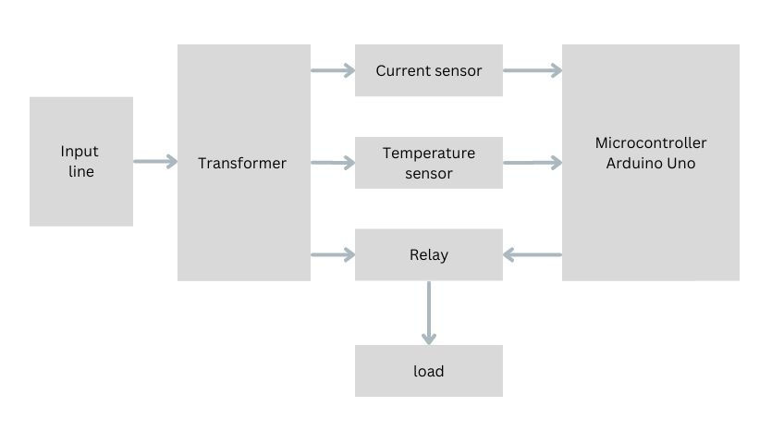
Block diagram

Slide 7
Working Principle
Monitoring:
The current sensor (ACS712) continuously measures the current flowing through the transformer.
The temperature sensor (LM35) monitors the transformer’s temperature.
Data Processing:
The Arduino receives data from the sensors.
It compares the readings with predefined safety thresholds.

Slide 8
Protection:
If the current or temperature exceeds safe levels, the Arduino triggers the relay module.
The relay disconnects the transformer from the load to prevent damage.
Reset:
The system remains disconnected until the issue is resolved, and the system is reset.

Slide 9
System Overview
Components:
Arduino: Controls the system.
Current Sensor: Measures load current.
Temperature Sensor: Measures transformer temperature.
Relay: Disconnects the transformer if needed.
Function:
Monitor: Continuously checks current and temperature.
Protect: Automatically disconnects transformer if thresholds are exceeded.

Slide 10
transformer
Definition:
A transformer is an electrical device that transfers electrical energy between two or more circuits using electromagnetic induction.
Basic Principle:
Operates on the principle of electromagnetic induction, where a varying current in the primary coil generates a varying magnetic flux, which induces a voltage in the secondary coil.
Purpose: Used to increase (step-up) or decrease (step-down) AC voltages in power transmission and distribution.
Applications: Power distribution, electrical isolation, impedance matching, voltage regulation in various electrical systems.

Slide 11
Arduino Microcontroller
Definition:
Arduino Microcontroller is a programmable device that acts as the brain of an electronic system. It processes inputs from sensors and controls outputs like motors, lights, or relays based on the programmed instructions.
Role: Central controller for the protection system.
Key Features:
Analog Inputs: Reads data from current and temperature sensors.
Digital Outputs: Controls the relay based on sensor readings.
Custom Code: Manages sensor data and decision-making logic.
Communication: Potential for data logging or remote monitoring.

Slide 12
Current Sensor
Function: Measures the electrical current flowing through the transformer.
Sensor Name: ACS712 Hall Effect Sensor
IC: ACS712
Connection: Outputs an analog voltage proportional to the current, which is read by the Arduino.
Purpose: Detects overload conditions by monitoring current levels and triggering protective actions if thresholds are exceeded.

Slide 13
Temperature Sensor
Function: Monitors the temperature of the transformer.
Sensor Name: LM35 Temperature Sensor
IC: LM35
Connection: Provides an analog output voltage proportional to the temperature, which is read by the Arduino.
Purpose: Detects overheating by continuously measuring the transformer’s temperature, ensuring it remains within safe operating limits.
Note: The LM35 is known for its accuracy and simplicity in temperature measurement.

Slide 14
Relay Module
Definition:
A relay is an electrically operated switch that uses an electromagnet to mechanically operate a switch, enabling the control of a high-power circuit with a low-power signal.
Function: Controls the connection and disconnection of the transformer from the load.
Relay Type: 5V Single-Channel Relay Module
Connection: Connected to the Arduino, which sends a signal to trigger the relay based on sensor data.
Purpose: Automatically disconnects the transformer to prevent damage when overload or overheating is detected.

Slide 15
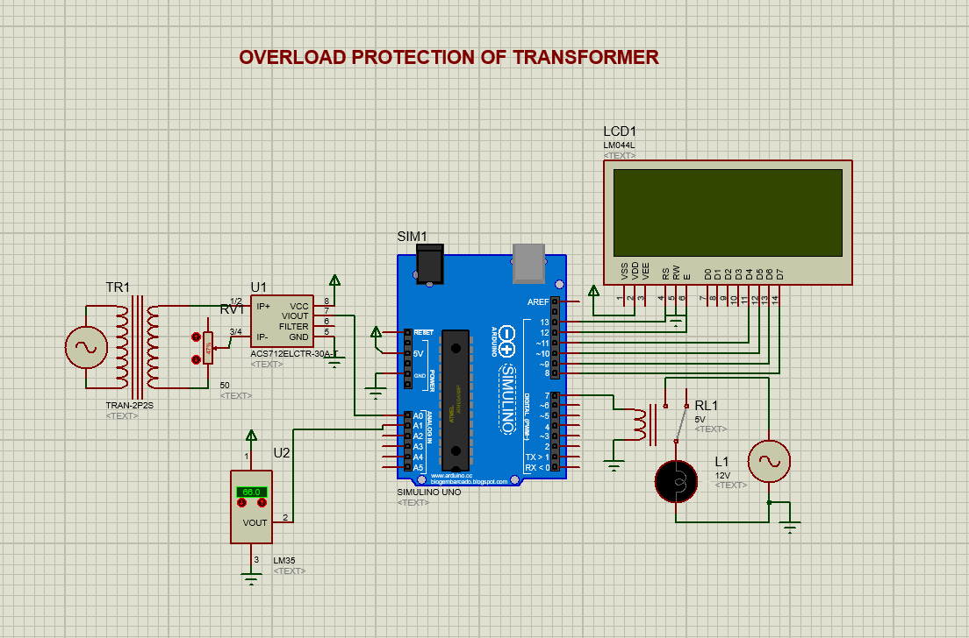
Circuit Diagram

Slide 16
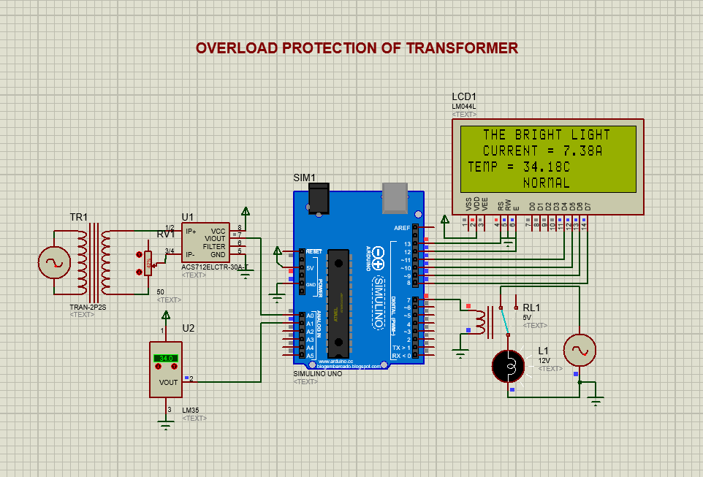
at normal loaded condition

Slide 17
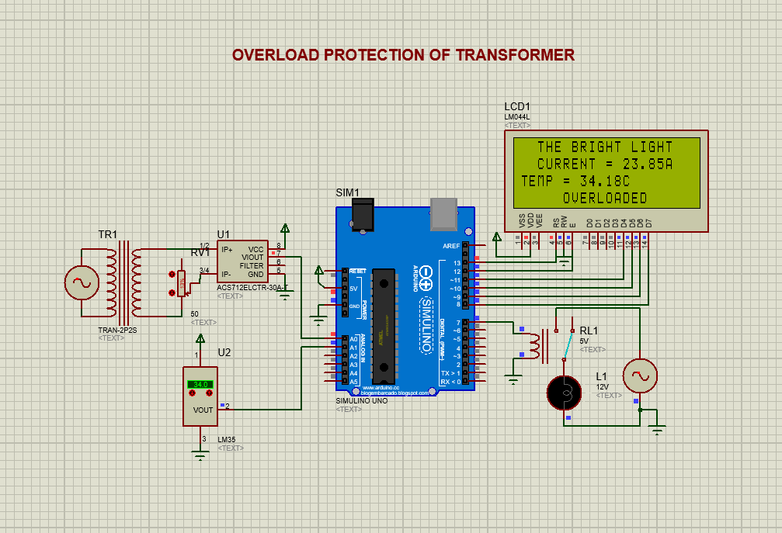
at overloaded condition

Slide 18
Cost estimation
s.no | Name of the components | quantity | cost
01 | Arduino UNO | 1 | 650
02 | Current sensor | 1 | 250
03 | Temperature sensor | 1 | 150
04 | Relay module | 1 | 100
05 | Bulb and Holder | Each 1 | 100
06 | LCD display | 1 | 650
07 | other |  | 700
 |  | Total | 2600

Slide 19
reference
Allegro Microsystems. ACS712 Current Sensor Datasheet. Retrieved from:
https://www.allegromicro.com
Texas Instruments. LM35 Temperature Sensor Datasheet. Retrieved from:
https://www.ti.com/lit/ds/symlink/lm35.pdf
Arduino. Arduino Programming Language Reference. Retrieved from:
https://www.arduino.cc/reference/en/
Spark Fun. Relay Module Guide. Retrieved from:
https://www.sparkfun.com
S. Rao, Power Transformer Maintenance.
Khanna Publishers, 2019.

Slide 20
Conclusion
This Arduino-based system successfully protects transformers from overload and overheating in a simple and cost-effective way.
It monitors the current and temperature in real-time to prevent damage to the transformer.
The system uses ACS712 (current sensor), LM35 (temperature sensor), and a relay to automatically disconnect the transformer if the current or temperature is too high.
This project shows that using Arduino can improve transformer safety and reliability in power systems.

Slide 21
THANK YOU
THANK YOU

